Slide 1
MGMT 3105-24F
SCOPE STATEMENTS
Scope, Charter and Organizational Structures
Lecture 3

Slide 2
PROJECT CHARTER

Slide 3
PMI’s Definition
A Project Charter is the process of developing a document that formally authorizes a project and documenting initial requirements that satisfy the stakeholders’ needs and expectations.
The approval of the Project Charter formally initiates the Project.

Slide 4
Charter Statement
A Charter statement is one of the documents produced in the planning phase of a project being managed and should include:
the Project Description;
the Project Purpose;
the Business Case;
the Project Deliverables;
the Project Milestones;
the Project Resources;
the Project Budget (gross amount only);
the Internal Stakeholders;
the External Stakeholders;
the Project Risks;
the Project Constraints;
the Team Members Roles and Responsibilities;
a Signed-Off approval of a review of the document with the customer, and
a Signed-Off approval of a review of the document with corporate management.

Slide 5
Key Statements
Writing, maintaining, and using an effective Project Charter is one of a project manager’s most important jobs.
When properly used, a Project Charter will be the single most important tool the project manager utilizes for managing the expectations of the project sponsor and all other stakeholders.
The Project Charter is used to set the project direction and defines the measures of success.
The Project Charter provides a consolidated and summary-level overview of the project. It allows all stakeholders to agree and document project scope, objectives, timeframe, and deliverables.
A Project Charter is created at the beginning of a project, approved by the stakeholders, and signed off before work can begin.
Every project should have a Project Charter created and maintained.
There is no official project without an approved Project Charter

Slide 6
Five Inputs for Developing a Project Charter
Project Statement of Work (with client)
Document including the high-level description of the intended deliverables
Business Need and Product Scope Definition
This is our “Project Brief” document
Fewer details than the Scope Statement
Business Case
Contract
Enterprise Environmental Factors (EFFs) (conditions we cannot control)
Organizational Process Assets (OPA) (business plans, processes, policies, protocols, and knowledge)

Slide 7
Typical Sections on a Project Charter
Project Title and Description:
This section includes a simple, high-level description of what is the project.
Business Case:
This section of the charter explains what business problem is being solved by the project.
It addresses the question of why the project is being undertaken.
Resources Preassigned:
In this section of the project charter, the sponsor identifies how many and what resources will be provided for the project.
Stakeholders:
This is the sponsor’s impression as to who are the stakeholders.
Stakeholder Requirements as Known:
This section of the project charter identifies the high-level requirements related to both project and product scope. Known stakeholder requirements are the requirements that have been used to justify the project.

Slide 8
Typical Sections on a Project Charter
Product Description/Deliverables:
This section includes the project sponsor’s indication of what specific product deliverables are wanted, and what will be the end result of the project.
A measure of project success is that all the deliverables are met.
Measurable Project Objectives:
This section addresses how the project ties into the organization’s strategic goals and includes the project objectives that support those goals.
Summary Milestone schedule:
Estimate the length of time to complete the various phases of the project.
Summary Budget:
Define the proposed budget for the project. Actual budget will be determined later once more planning has been completed.

Slide 9
Typical Sections on a Project Charter
Project Approval Requirements:
This section identifies what items need to be approved for the project, and who will have sign-off.
High Level Project Risks:
Potential threats and opportunities for the project are listed here. In-depth risk identification occurs later in the planning processes.
Signatures:
This is where all the involved parties sign-off on the proposed project and authorize it to begin based upon the information presented.

Slide 10
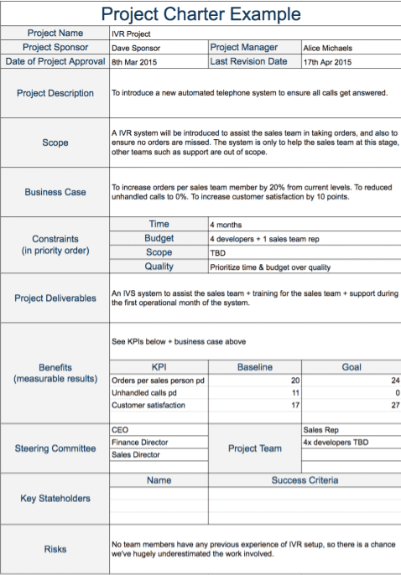
Outputs of the Project Charter
Project Purpose or Justification;
Measurable Project Objectives;
High-level Requirements;
High-level Project Description;
High-level Risks;
Summary Milestone Schedule; and,
Summary Budget.

Slide 11
Benefits of Using a Project Charter
Stakeholders are clearly defined;
Communication channels are defined;
Roles and Responsibilities are outlined;
Scope is Defined – Helps prevent “Scope Creep”;
Improved Project Management Processes in later Phases;
Increased Probability of project success;
“BUY IN” from Project Team Members.

Slide 12
Summary
A Project Charter officially initiates a Project;
Project Charters are a High-level view of the project objectives, deliverables, and scope;
Project Charters are living documents and need to be updated as the project moves forward;
There are standard inputs and tools & techniques for building a Project Charter. “One Size” does not fit all; and,
A well managed Project Charter will be the single most important tool for a Project Manager/Project Leader to manage project expectations.

Slide 13
Stakeholder Management
What is a “Stakeholder"?
Individuals or groups who have an active stake (interest) in the project and can potentially impact its development.

Slide 14
Identifying Project Stakeholders
Internal:
Senior Management
Accountant
Team members
I.T. Department
External:
Client
Competitors
Suppliers
Environmental Agencies
Government Agencies
Research Laboratories

Slide 15
Manage Stakeholders
I
d
e
n
t
i
f
y
S
t
a
k
e
h
o
l
d
e
r
s
I
m
p
l
e
m
e
n
t
G
a
t
h
e
S
r
t
a
k
e
h
o
l
d
e
r
I
n
f
o
r
m
a
t
i
M
o
n
a
n
a
g
e
m
e
n
t
o
n
S
t
a
k
e
h
o
l
d
e
r
S
s
t
r
a
t
e
g
y
P
r
o
j
e
c
t
M
a
n
a
g
e
m
e
n
P
t
r
e
d
i
c
t
I
d
e
n
t
i
f
T
y
e
a
S
m
t
a
k
e
h
o
l
d
e
r
S
t
a
k
e
h
o
l
d
e
r
s
'
B
e
h
a
v
i
o
r
M
i
s
s
i
o
n
I
d
e
n
t
i
f
y
D
e
t
e
r
m
i
n
e
S
t
a
k
e
h
o
l
d
e
r
S
t
a
k
e
h
o
l
d
e
r
S
t
r
a
t
e
g
y
S
t
r
e
n
g
t
h
s
a
n
d
W
e
a
k
n
e
s
s
e
s

Slide 16
MANAGE AND CONTROL
STAKEHOLDER ENGAGEMENT
Communicate and work with all the stakeholders to meet their needs.
You do this to increase support for the project and minimize resistance and issues from everybody involved.
How?
Listen to them, talk to them, communicate with them.
Help them along, teach them when needed.

Slide 17
Scope Statement
A Scope statement is one of the first documents produced in the Planning Phase of a project being managed and should include:
the Project Statement;
the Acceptance Criteria;
the Validation/Testing Plan;
the Project Deliverables;
the Project Exclusions;
the Project Constraints;
the Project Coordination;
a Signed-Off approval of a review of the document with the customer, and
a Signed-Off approval of a review of the document with corporate management.
Remember: The Scope Statement needs to be specific and with as much detail as possible.
Future changes here are to be avoided, but possible.

Slide 18
Project Scope Management Processes
Planning scope: Determining how the project’s scope and requirements will be managed.
Collecting Defining and documenting the features and functions
requirements: of the products produced during the project as well as the processes used for creating them.
Defining scope: Reviewing the Project Charter, requirements documents, and organizational process assets to create a Scope Statement.
Creating WBS: Subdividing the major project deliverables into smaller, more manageable components.
Validating scope: Formalizing acceptance of the project deliverables during Closing.
Control scope: Controlling changes to project scope throughout the life of the project.

Slide 19
Defining Scope
Scope Statements should include at least a product scope description, product user acceptance criteria, and detailed information on all project deliverables.
It should also document other scope-related information, such as the project boundaries, constraints, and assumptions.
The Scope Statement should also reference supporting documents, such as product specifications.
As time progresses, the scope of a project should become clearer and more specific.

Slide 20
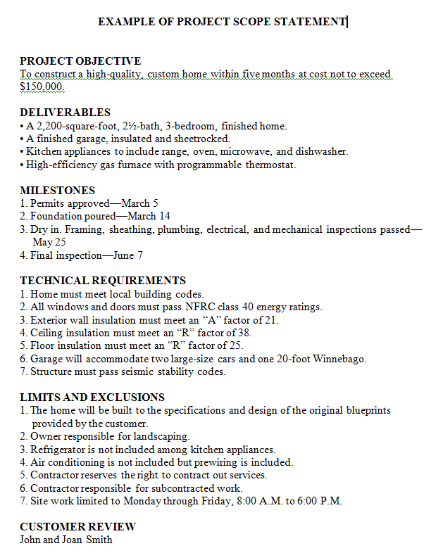
Scope Statement Example

Slide 21
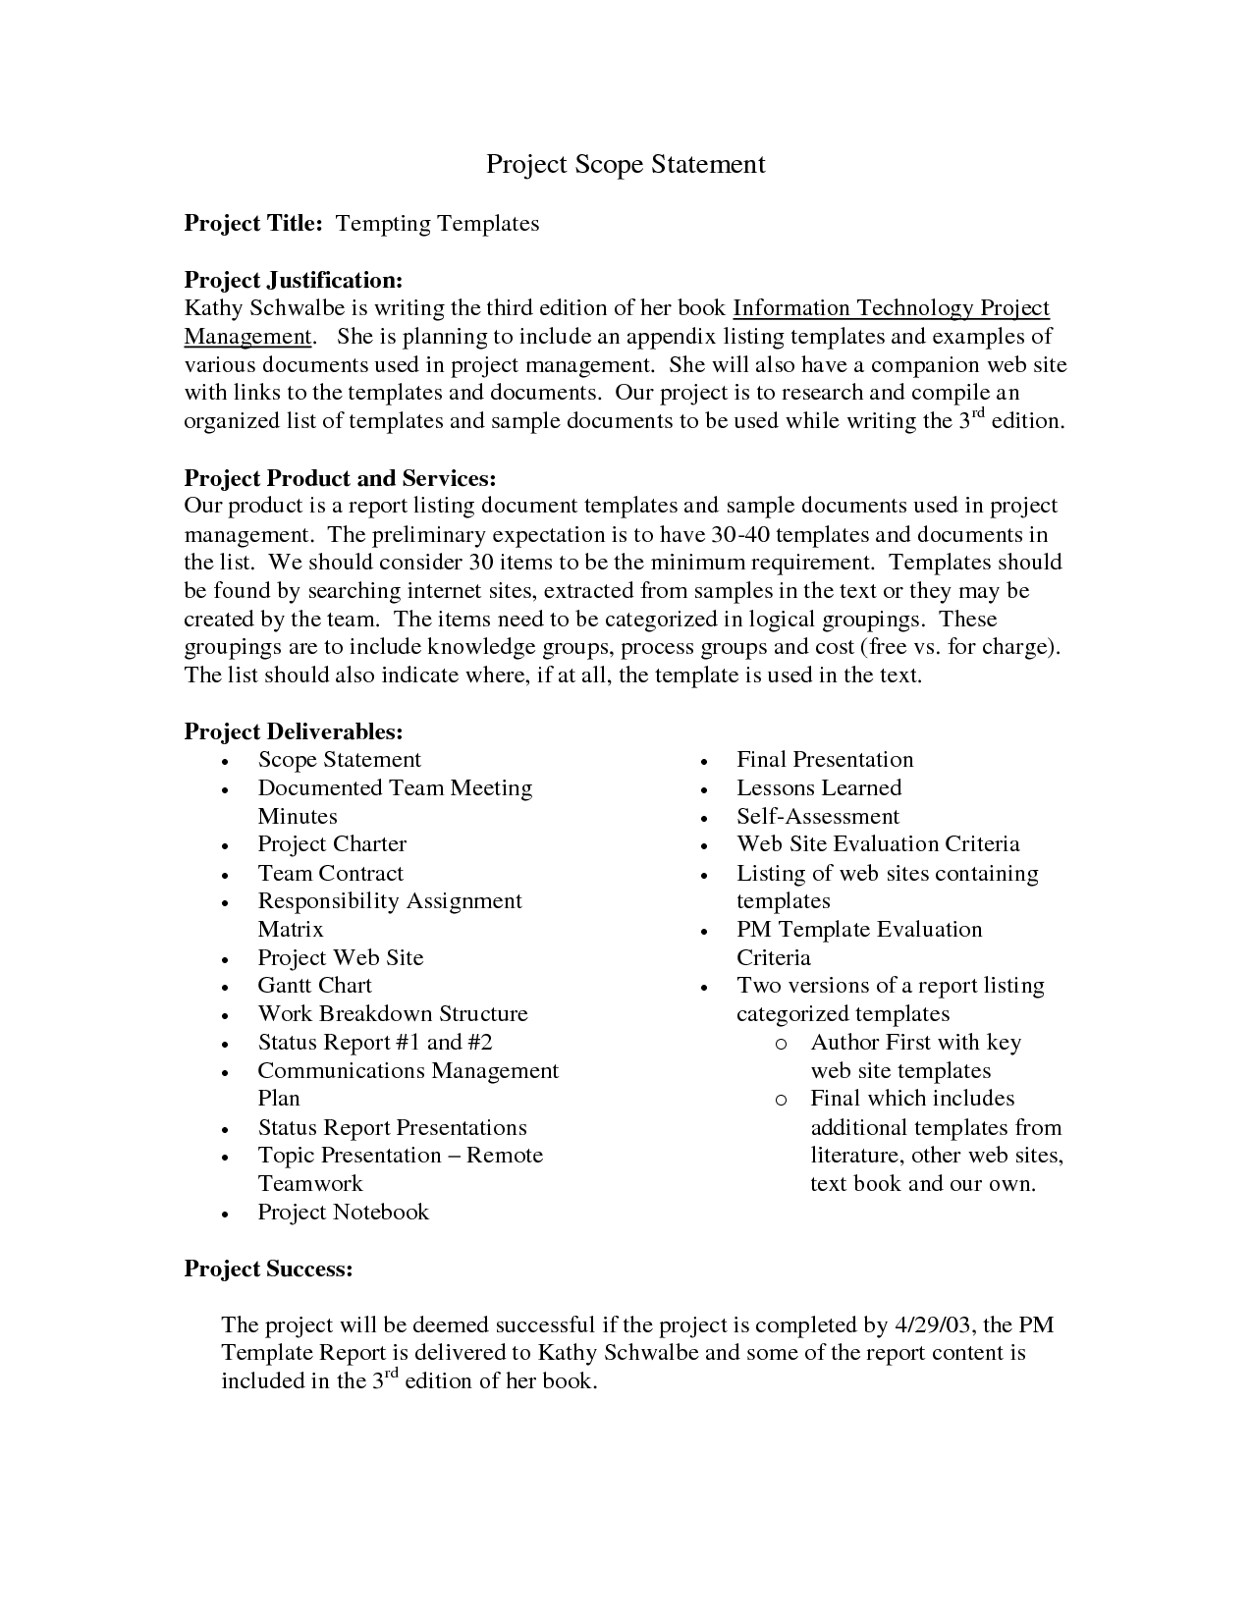
Scope Statement Example

Slide 22
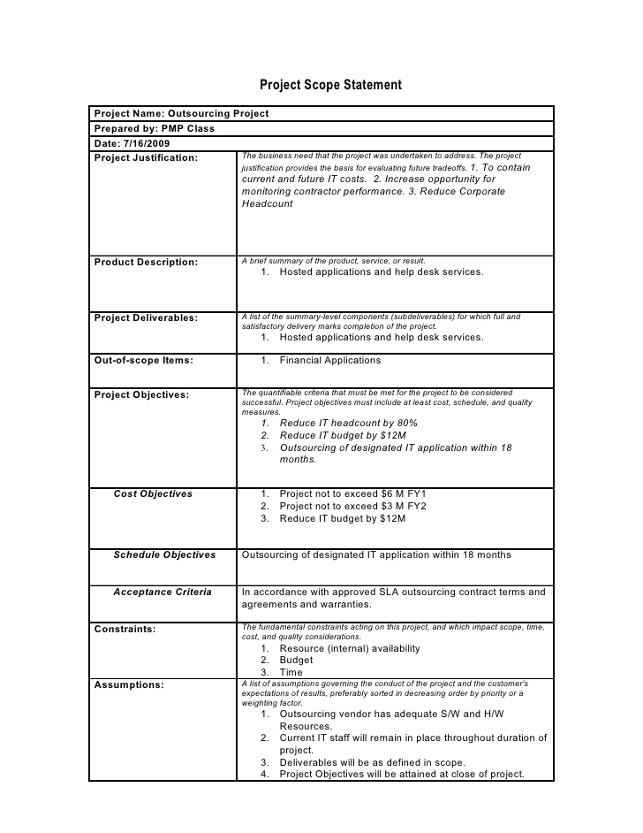
Scope Statement Example

Slide 23
Scope Management Plan
A Project Scope Management Plan is the document that describes how scope and scope changes will be managed.
A scope management plan provides advantages:
Less scope creep, fewer scope changes, less scope conflict, improved communications, and better customer satisfaction are achieved.
The plan is often executed as an extension of the Management by Objectives (MBO) Philosophy which says an organization should:
Establish unambiguous and realistic objectives
Periodically evaluate if objectives are being met
Take corrective action

Slide 24
Scope Creep
Project scope creep is insidious and sneaking up suddenly and hitting you and your project where it hurts.
We all need to be careful about dealing with increasing or changing scope in order to avoid nasty surprises.
Commonly speaking, scope creep is how a project’s requirements tend to increase over a project lifecycle such as follows:
What once started out as a single deliverable becomes five.
A product that began with three essential features, now must have ten.
Midway through a project, the needs of customers change, prompting a reassessment of the project requirements.

Slide 25
Scope Creep
Scope creep is typically caused by key project stakeholders changing requirements, or sometimes from internal miscommunication and disagreements.
While it might result in project delays, roadblocks, or going over budget, scope creep is not necessarily a bad thing. Remember that change is inevitable. Customer needs to do change over time and delivering a project that answers their needs often means altering the scope.
Scope creep is therefore a reality that every good project manager expects and plans for.

Slide 26
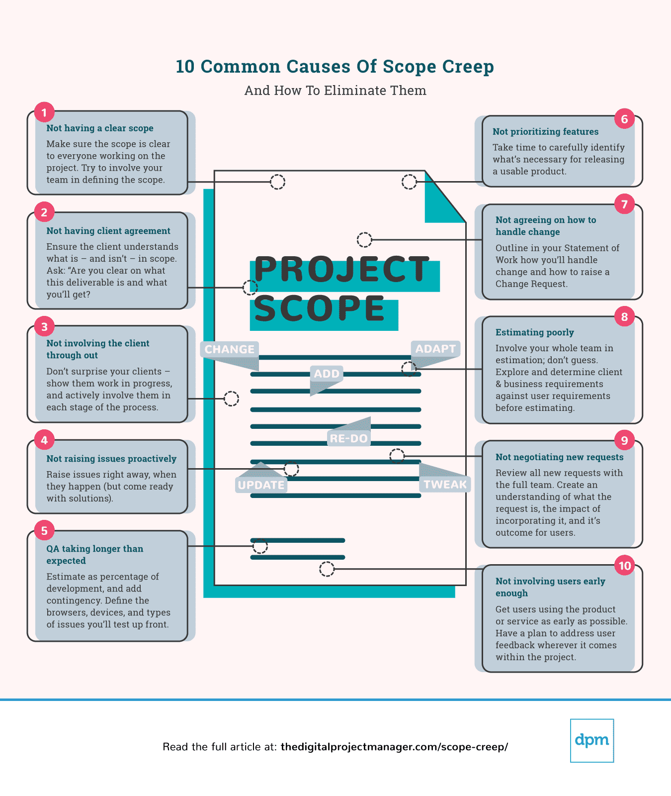

Slide 27
The Organizational Context

Slide 28
Organizational Culture
Every organization develops its own unique outlook, operating policies, procedures, patterns of thinking, attitudes, norms of behavior. They are often as unique as a fingerprint.
No two organizations no matter how similar in size, products, operating environment, profitability, ... are the same.

Slide 29
What is Organizational Culture?
Defined as: “The solution to external and internal problems that has worked consistently for a group and that is therefore taught to new members as the correct way to perceive, think about and feel in relation to these problems.”
They develop over time

Slide 30
Key factors that affect the development of a Culture
Technology:
(use of email, telephone, meetings);
Environment:
(automotive, aerospace, government, CO2 emissions regulations, government subsidies);
Geographical Location:
(Daimler-Chrysler merger failure, Mexican or Chinese LCC);
Reward Systems:
(hourly pay, salary, bonus);
Rules and Procedures:
(rule: 40 hrs/week, really expected: 45 hrs);
Key Organizational Members:
(founder of the organization forms culture, Bill Gates); and,
Critical Incidents:
(become part of the company's lore, either for good or for bad).

Slide 31
How does Culture Affect Projects?
Department interaction: Cultures favoring cooperation between functional groups and new projects are much more successful than those that adopt a disinterested or even adversarial relationship.
Employee commitment to goals: Projects depend on the commitment and motivation of the team members. Team members must understand the why in order to be motivated.

Slide 32
How does Culture Affect Projects?
Project planning "Padding" of duration estimates when it is not acceptable to be late, but it is acceptable to plan poorly.
Performance evaluation When a culture sends the signal that the goal of the firm is to create innovative new products, it reinforces a project management culture that is aggressive and offers potentially high payoffs (and the occasional significant loss!).

Slide 33
Organizational Structure
How are the lines of hierarchy and communication arranged within a company?
Company structure affects projects.
What/When people are available to work?
How do you get the people?

Slide 34
Common Organizational Structures
Functional Organizations
Project Organizations
Matrix Organizations

Slide 35
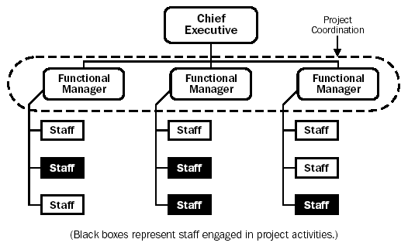
1. FUNCTIONAL ORGANIZATIONS
Each employee has one clear supervisor.
Employees are grouped by specialty such as: production, marketing, engineering.
Every department does their own projects independent of other departments.

Slide 36
PROJECTS IN FUNCTIONAL ORGANIZATIONS
Strengths for PM Weaknesses for PM
Company doesn't have to restructure or disrupt operations.
Everybody really knows their stuff.
Everybody knows their place in the company.
Too many layers to get through to talk to people.
Lack of customer focus.
Projects take longer because people are busy in their areas and have other priorities.
I really just want to load the materials on the trucks for the guys.
Do I really have to do this project?

Slide 37
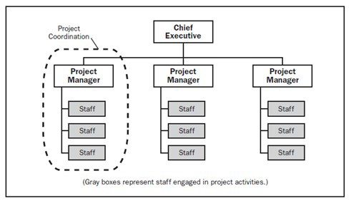
2. PROJECT ORGANIZATIONS
Opposite end of the spectrum from Functional Oranizations
Team members are usually all located together.
Company just does projects

Slide 38
STRENGTHS AND WEAKNESSES OF
PROJECT ORGANIZATIONS
Strengths for PM
Weaknesses for PM
Employees report to one person usually.
Communication is easier
Promotes effective and speedy decision making.
Develop strong project managers and encourages rapid response to market opportunities.
Setting up and maintaining teams can be expensive.
Potential for project team members to develop loyalty to the project rather than the overall organization.
Difficult to maintain a pooled supply of intellectual capital.
Concern among project team members about their future once the project ends.

Slide 39
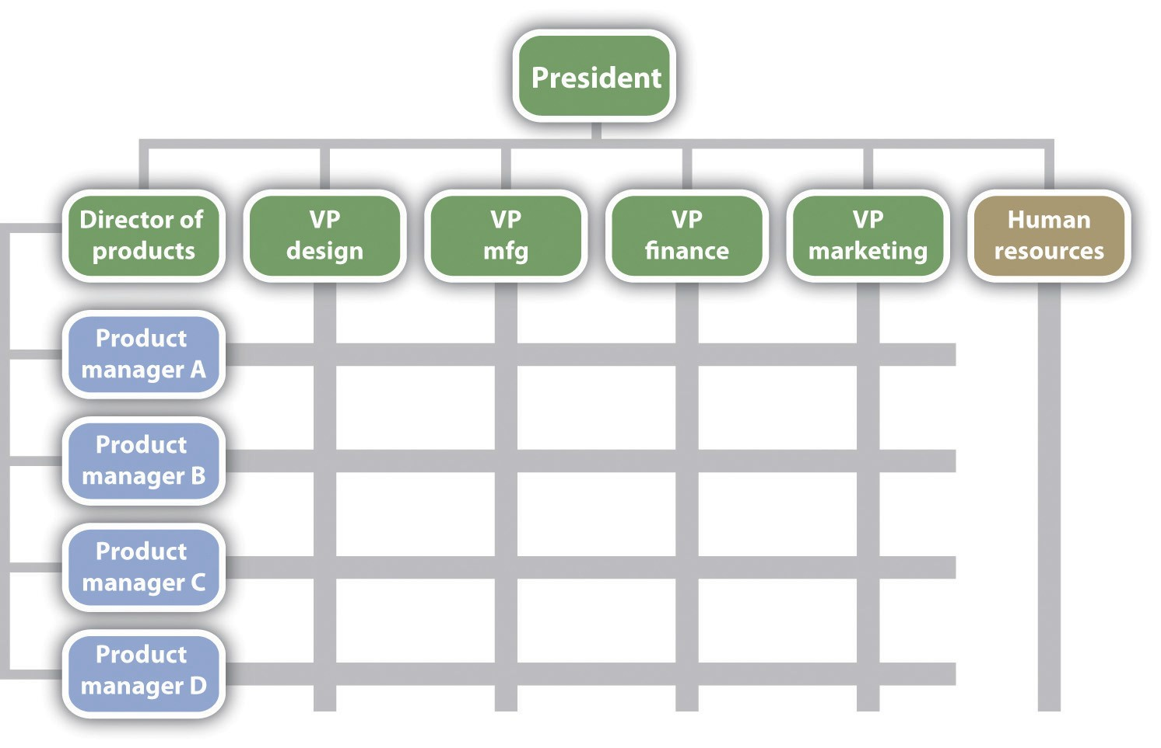
3. MATRIX ORGANIZATIONS
Blend between functional organization and project organization.
Classified as weak, balanced or strong.
Depending on how much influence the Project Manager has.

Slide 40
STRENGTHS AND WEAKNESSES OF MATRIX ORGANIZATIONS
Strengths for PM
Weaknesses for PM
Suited to dynamic environments.
Emphasizes the dual importance of project management and functional efficiency.
Promotes coordination across functional units .
Maximizes scarce resources between competing project and functional responsibilities.
Dual hierarchies mean two bosses.
Requires significant time to be spent negotiating the sharing of critical resources between projects and departments.
Can be frustrating for workers caught between competing project and functional demands.

